Slide 1
Graduation project
software of the automated forecasting of changes in product's value under its modifications.
Lukianova K. Yu.
Student group ПІ-13-1
Created by
Mentor
Docent Vorochek O. G.

Slide 2
Relevance
Poor estimation of projects value is one of the main reason why project is not completed on time and on budget, delivering the expected value.
There is a necessity in automated approach of estimating projects value under its modifications

Slide 3
Purpose of development
The aim is
to create software of the automated forecasting of changes in product's value under its modifications by using bottom-up estimation method which supposed that the cost of each activity is determined, including the cost of human hours, the cost of equipment, the cost of materials;
provide the ability to analyze projects financial condition by making corresponding diagrams.

Slide 4
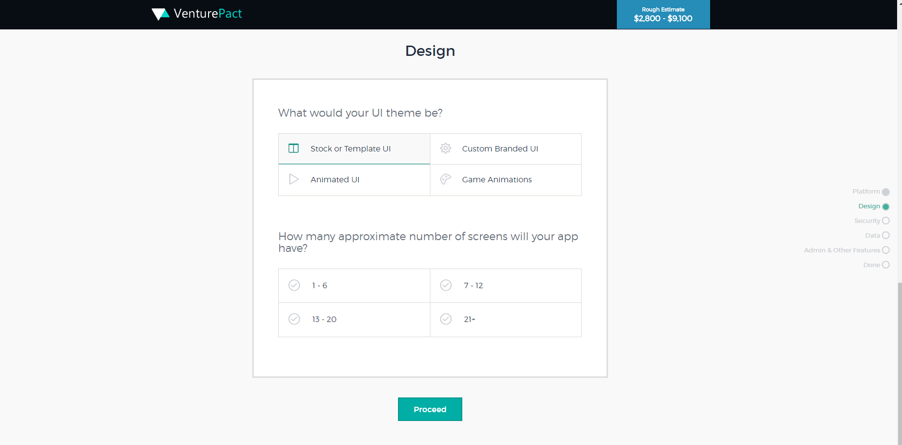
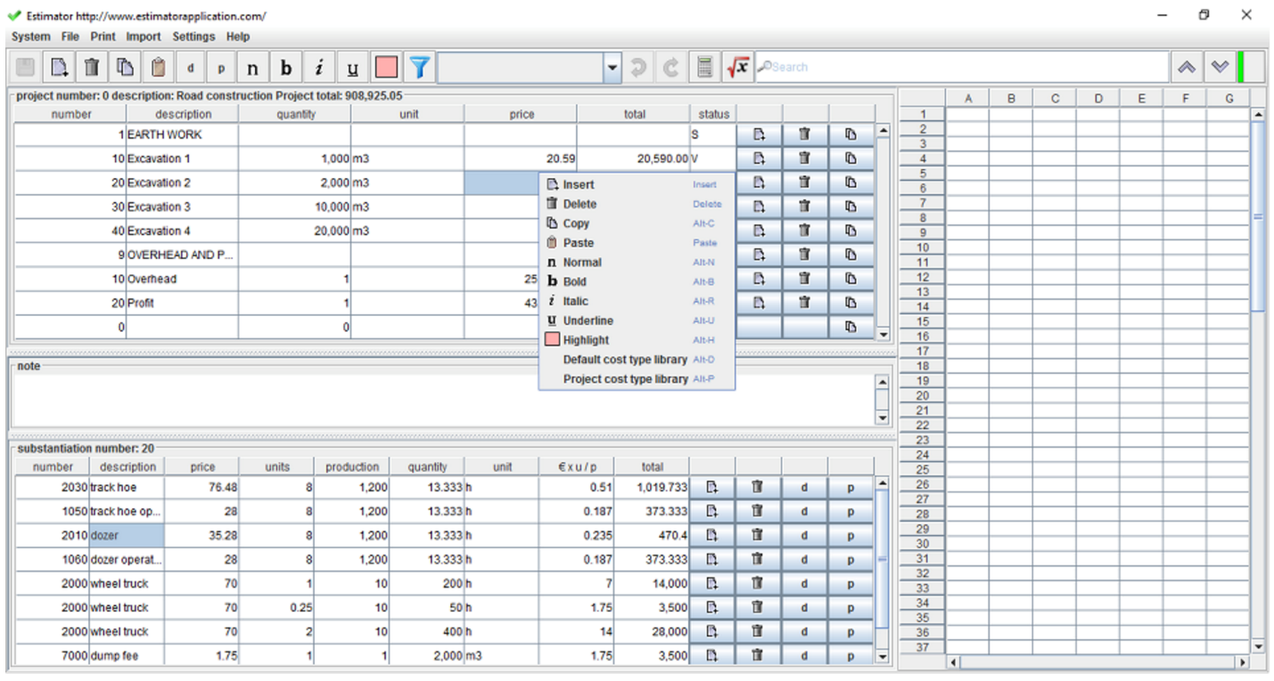
Analogues analysis
Venturepact Web application
Estimator desktop application

Slide 5
Problem statement
conduct an analysis, UML and conceptual domain modeling;
develop a database schema as storage of all data regarding users, projects and change requests;
develop algorithms of forecasting estimation of project value under its modifications;
implement software application of estimation project’s value under its modifications.

Slide 6
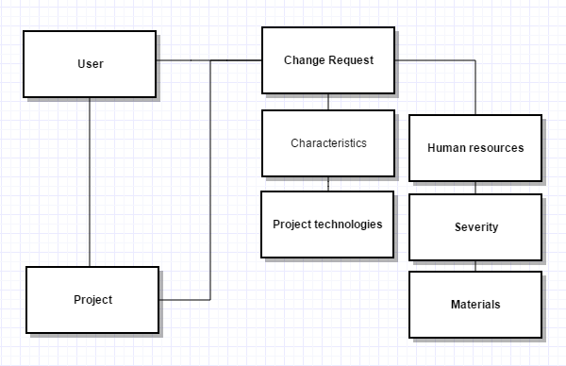
Conceptual modeling of the subject area

Slide 7
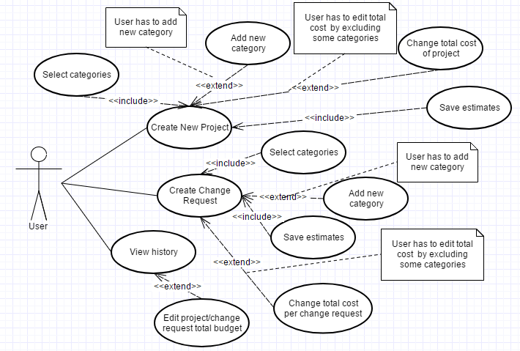
UML modeling

Slide 8
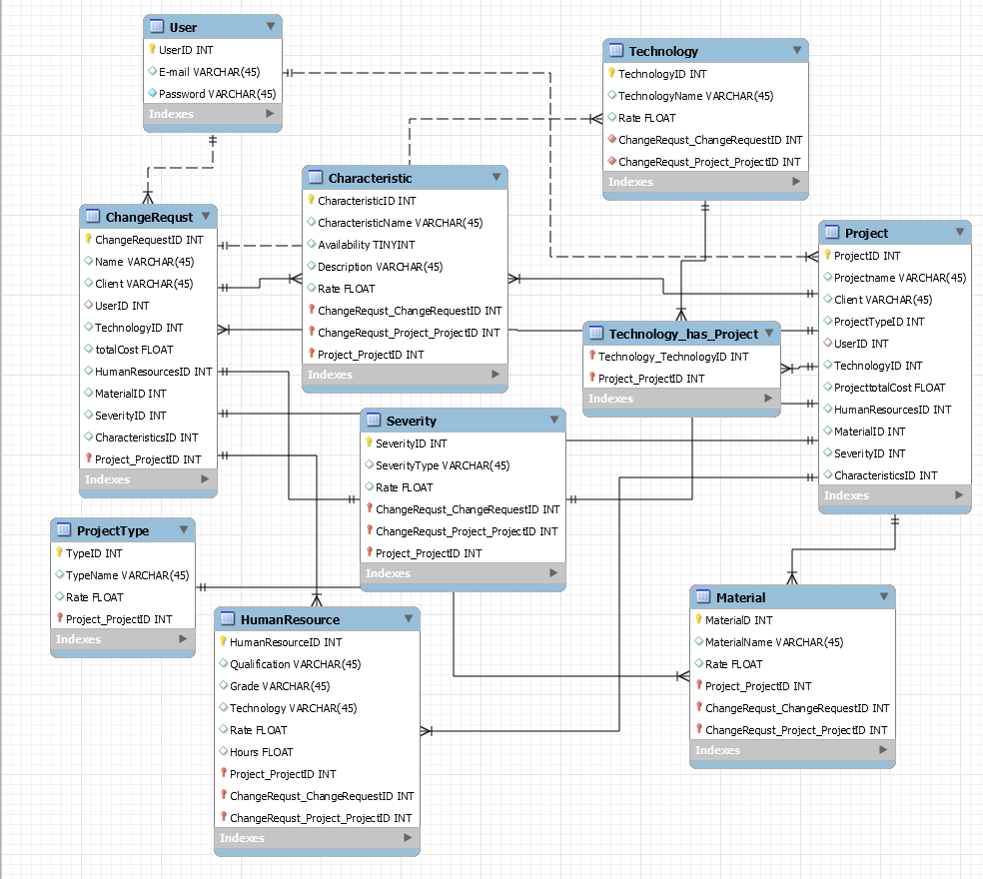
Database schema

Slide 9
Development tools
Pycharm Jetbrains as development environment
Python as programming language
Django framework
SQLite database for storage information
Html 5, CSS 3
JavaScript and Jquery

Slide 10
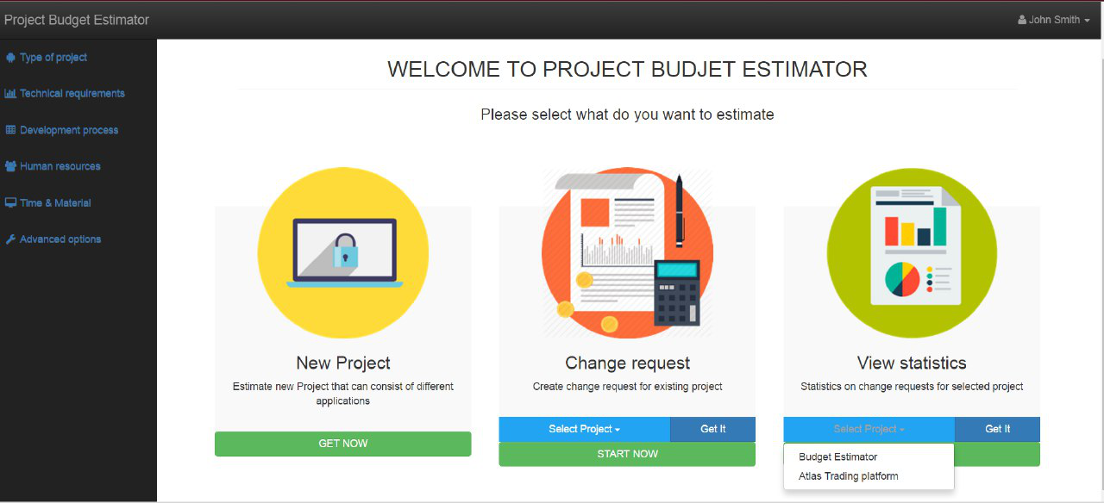
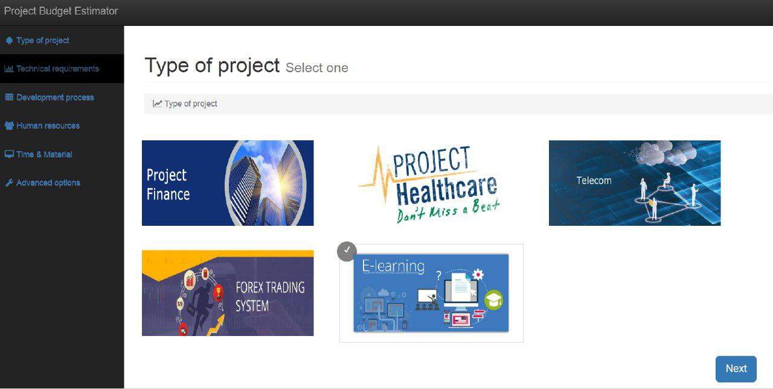
User Interface

Slide 11
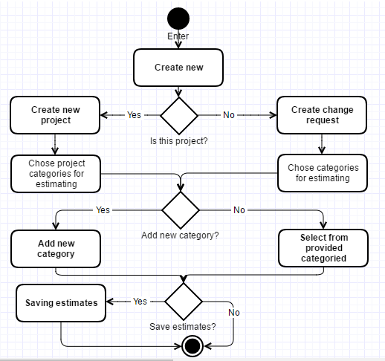
Algorithm of estimating project’s value

Slide 12
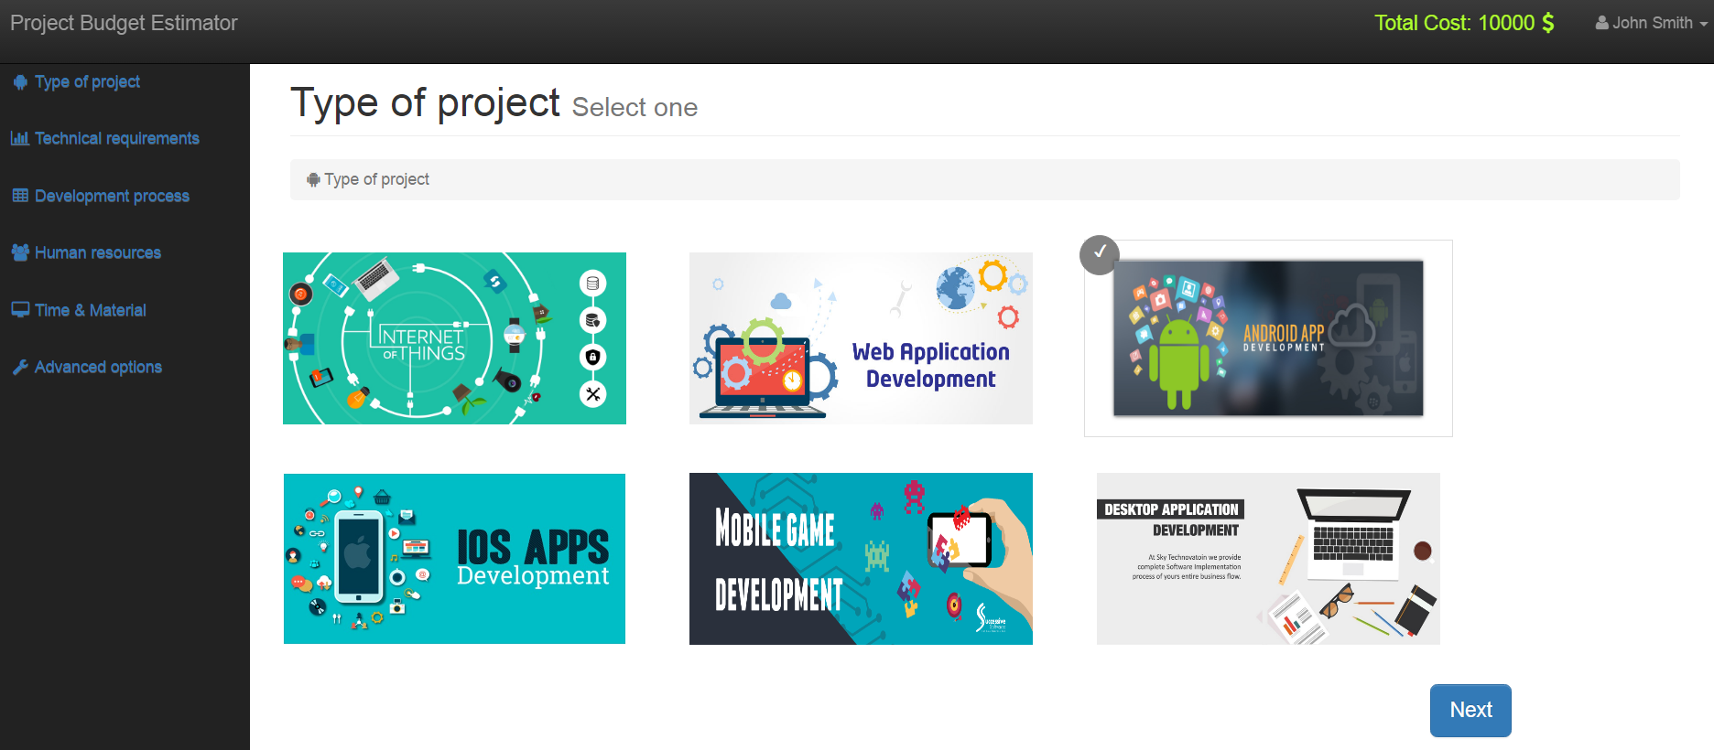
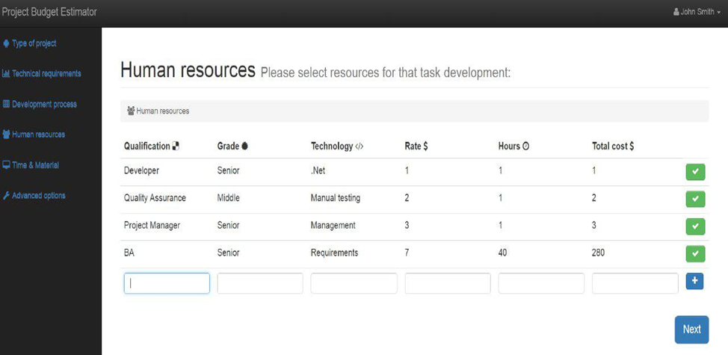
User Interface

Slide 13
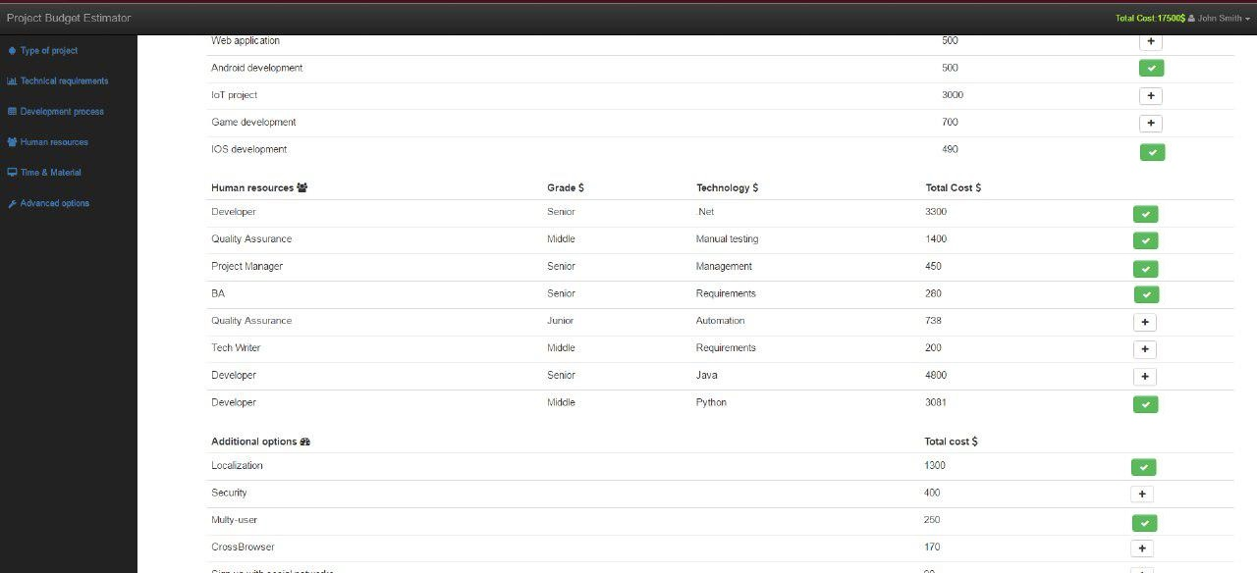
User Interface

Slide 14
Conclusions
analysis, UML modeling and conceptual domain;
developed database schema that includes needs of domain area;
implemented software application of estimation project’s value including its change requests.
By results of graduation project, abstracts were published in Polish Journal of Science and Practice

